Slide 1
Pulseq MR course
Pulseq in a Browser and Basic Sequences
Prof. Dr. Moritz Zaiss
Department for Artificial Intelligence in Biomedical Engineering
University Clinic Erlangen, Friedrich-Alexander University (FAU) Erlangen-Nürnberg
moritz.zaiss@fau.de
www.mr-physik.med.fau.de/ag-zaiss

Slide 2
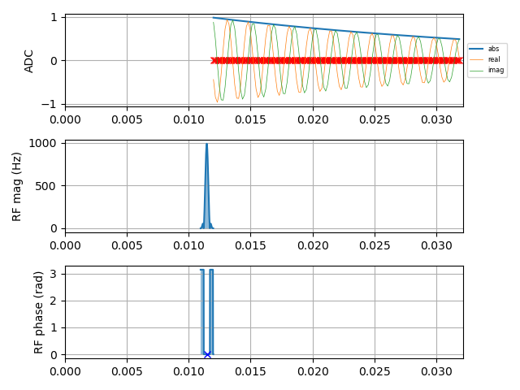
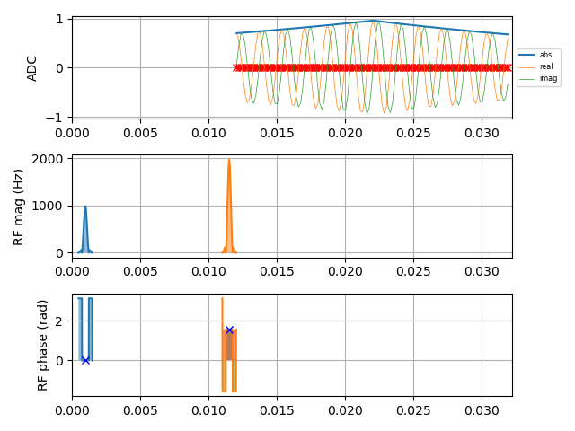
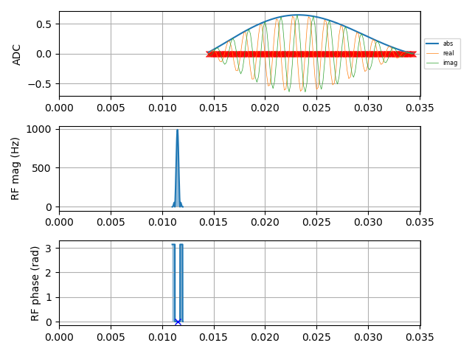
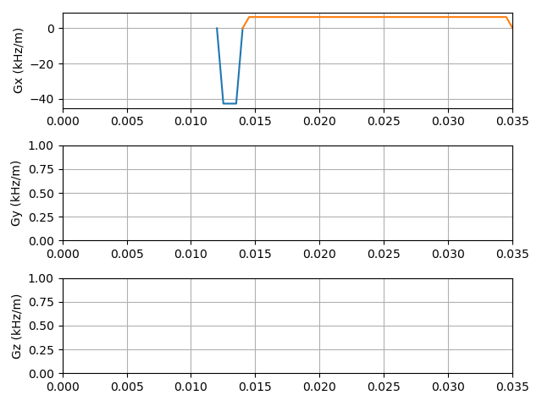
Basic Sequences
FID
spin echo
gradient echo
t [s]
t [s]
t [s]

Slide 3
Basic Sequences
FID
spin echo
2D
gradient echo
t [s]
t [s]
t [s]
t [s]

Slide 4
Basic Sequences
FID
spin echo
2D
gradient echo
t [s]
t [s]
We want to create these sequences in Pulseq
We want to do it in python using PyPulseq
We want to do it in a Browser using Google Colab Notebook / Jupyter Notebooks
t [s]
t [s]

Slide 5
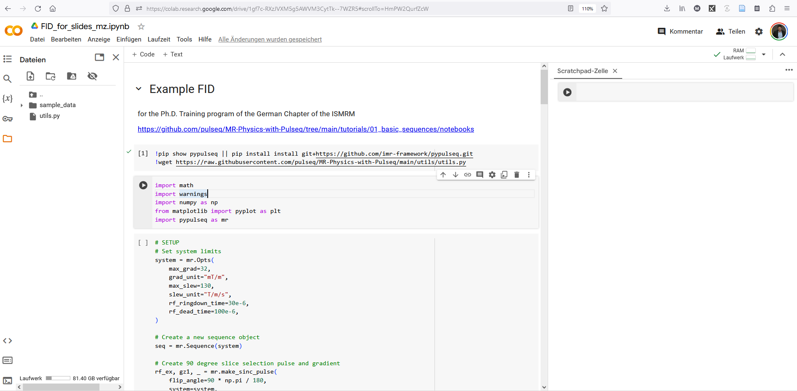
Google Colab – Jupyter Notebooks

Slide 6
Google Colab – Jupyter Notebooks
Text cell
Files and variables
Scratchpad:
run any code,
like a terminal
Code cell
Run this cell

Slide 7
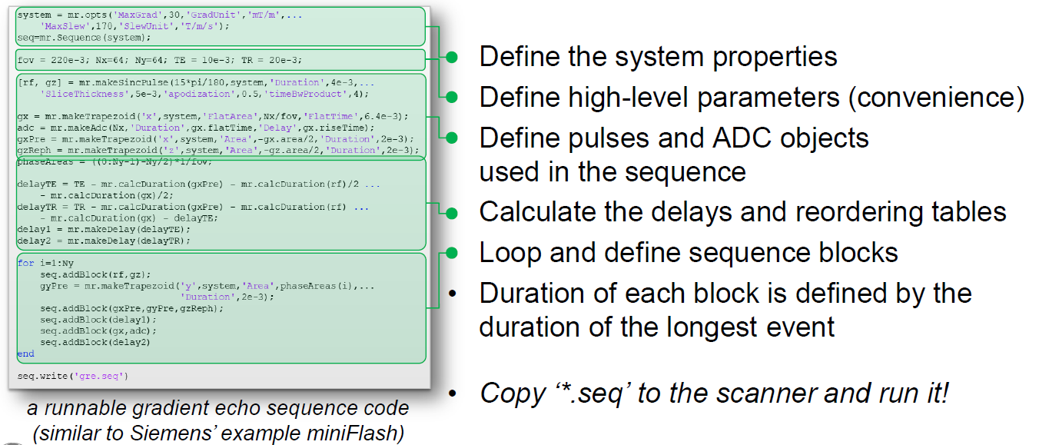
Pulseq workflow

Slide 8
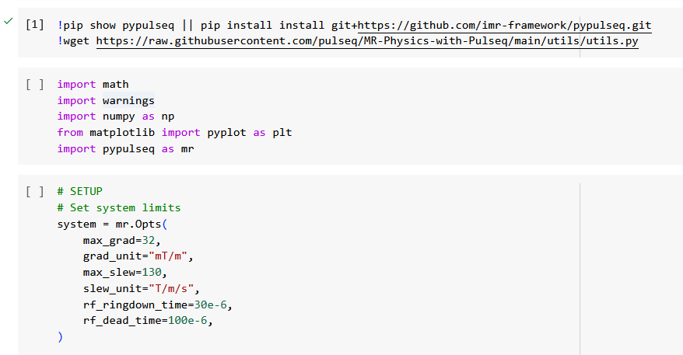
Colab - Setup and Define System Properties
Install the latest version of pypulseq
Import required packages
pypulseq as mr
Setup and MR system with scanner limits (matching your scanner)

Slide 9
Basic Sequences
FID
RF pulse
ADC event
t [s]

Slide 10
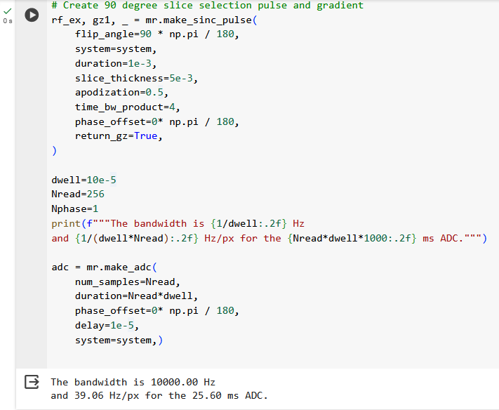
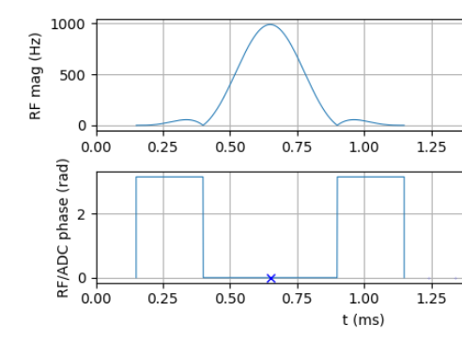
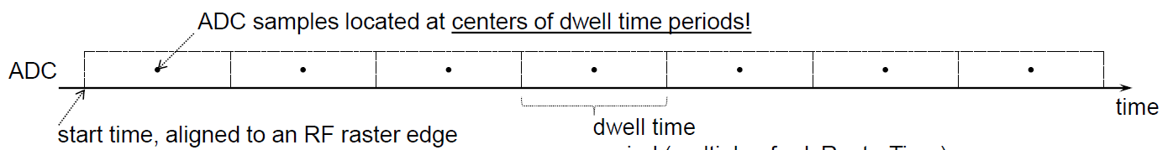
Colab – Define Pulses and ADC objects
Make_sinc_pulse
Make_adc

Slide 11
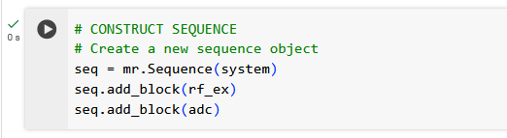
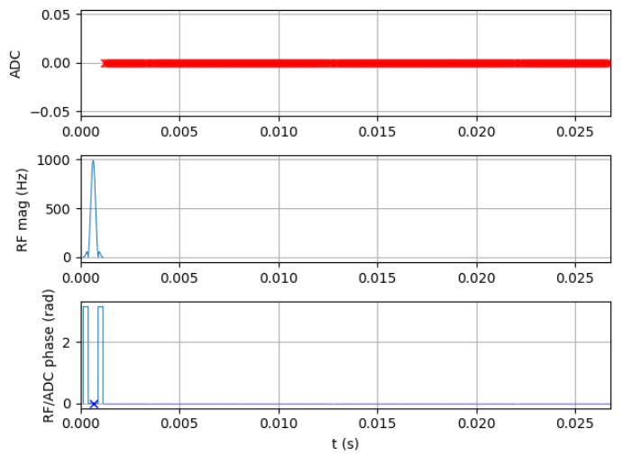
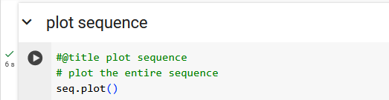
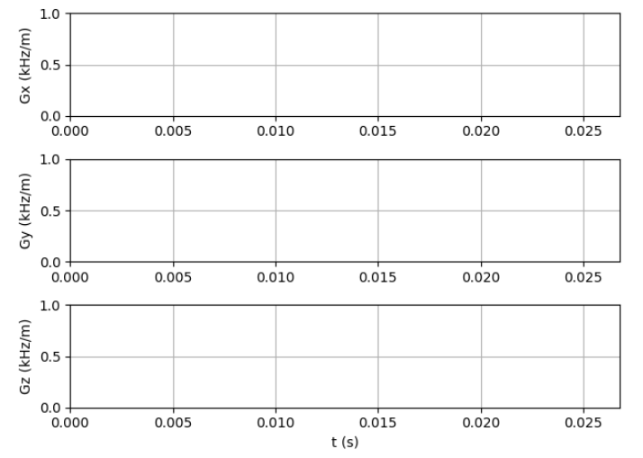
Colab – Construct FID Sequence

Slide 12
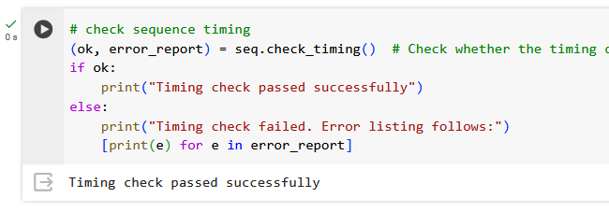
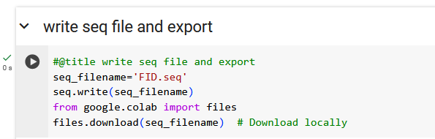
Colab – check_timing if passed: seq.write

Slide 13
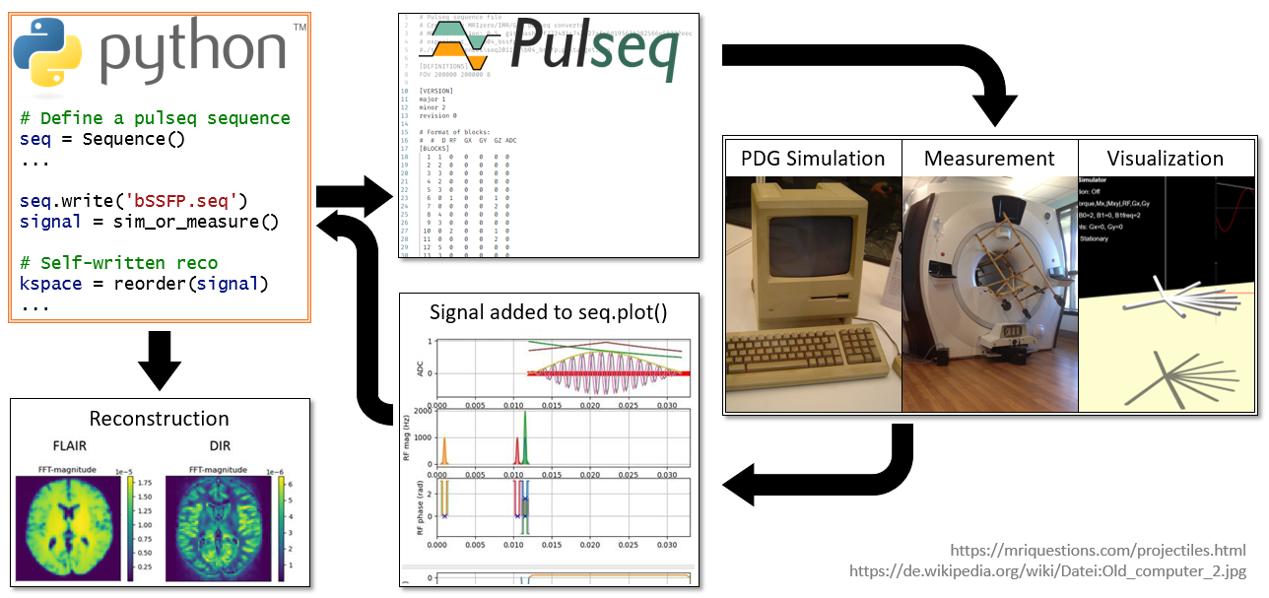

Slide 14
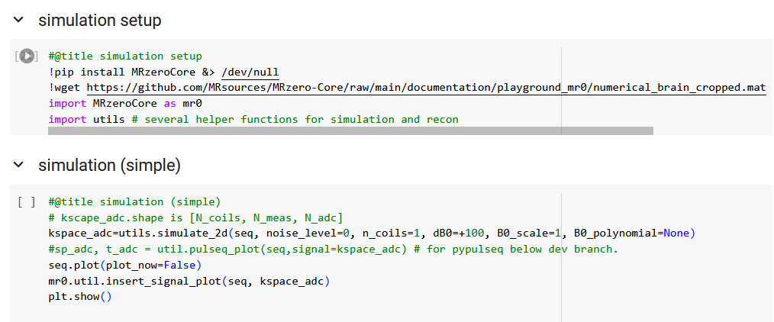
Colab – MR-zero simulation (simple)

Slide 15
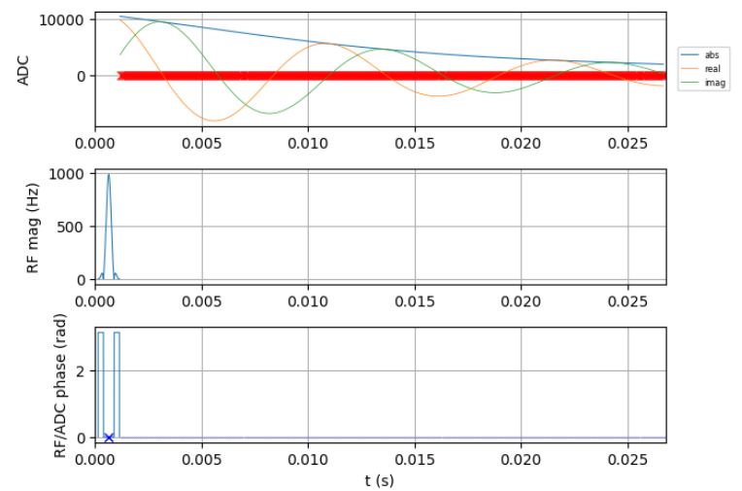
Colab – MR-zero simulation (simple)

Slide 16
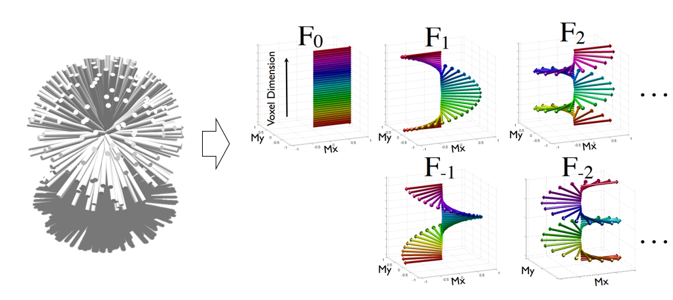
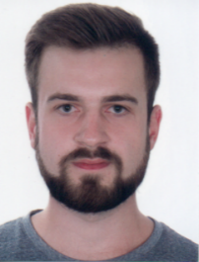
Features and Limitations of our simulation
Phase Distribution Graph simulation
EPG-based simulation
full echo shape
full encoding
arbitrary timing
Instantaneous pulses (center pulse assumed)
no slice profile, no rf off-resonance, no SMS ->mr.simRf.m ->Tony Stöcker
Pulseq standard >1.2 required, tested until 1.4
Jonathan Endres
Endres J, Dang N, Glang F, Loktyushin A, Weinmüller S, Zaiss M. Phase distribution graphs for differentiable and efficient simulations of arbitrary MRI sequences. In: Proc. ISMRM 30, 2022

Slide 17
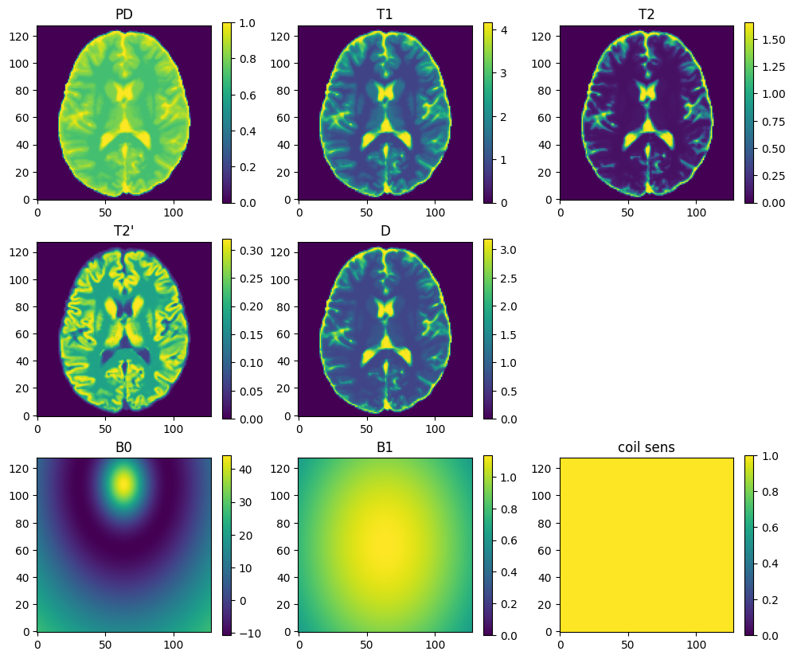
Features and Limitations
PD, T1, T2, T2’, D(isotropic), B0, B1 (all static)
compartments possible
1D/2D/3D possible
Differentiable

Slide 18
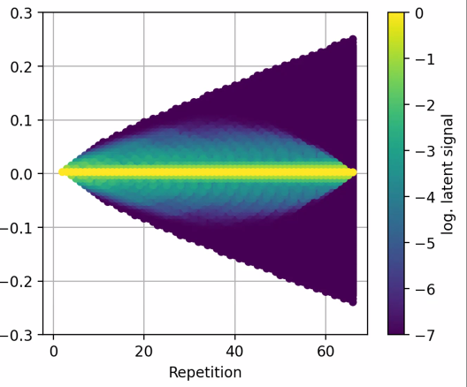
Features and Limitations
PD, T1, T2, T2’, D(isotropic), B0, B1 (all static)
compartments possible
1D/2D/3D possible, mimicking MRS is possible
Differentiable
Faster than isochromat solutions
EPG state analysis possible
Recon: Adjoint, FFT, soon: GRAPPA/SENSE
phase graphs: graph.plot()
bSSFP
RARE

Slide 19
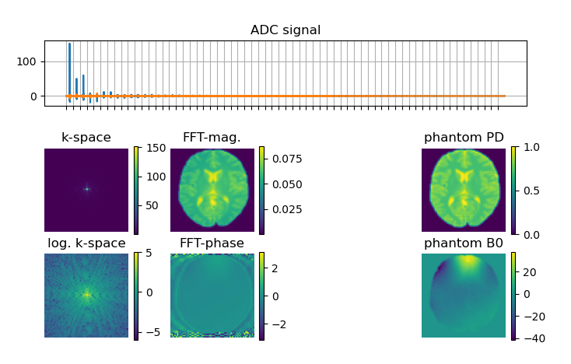
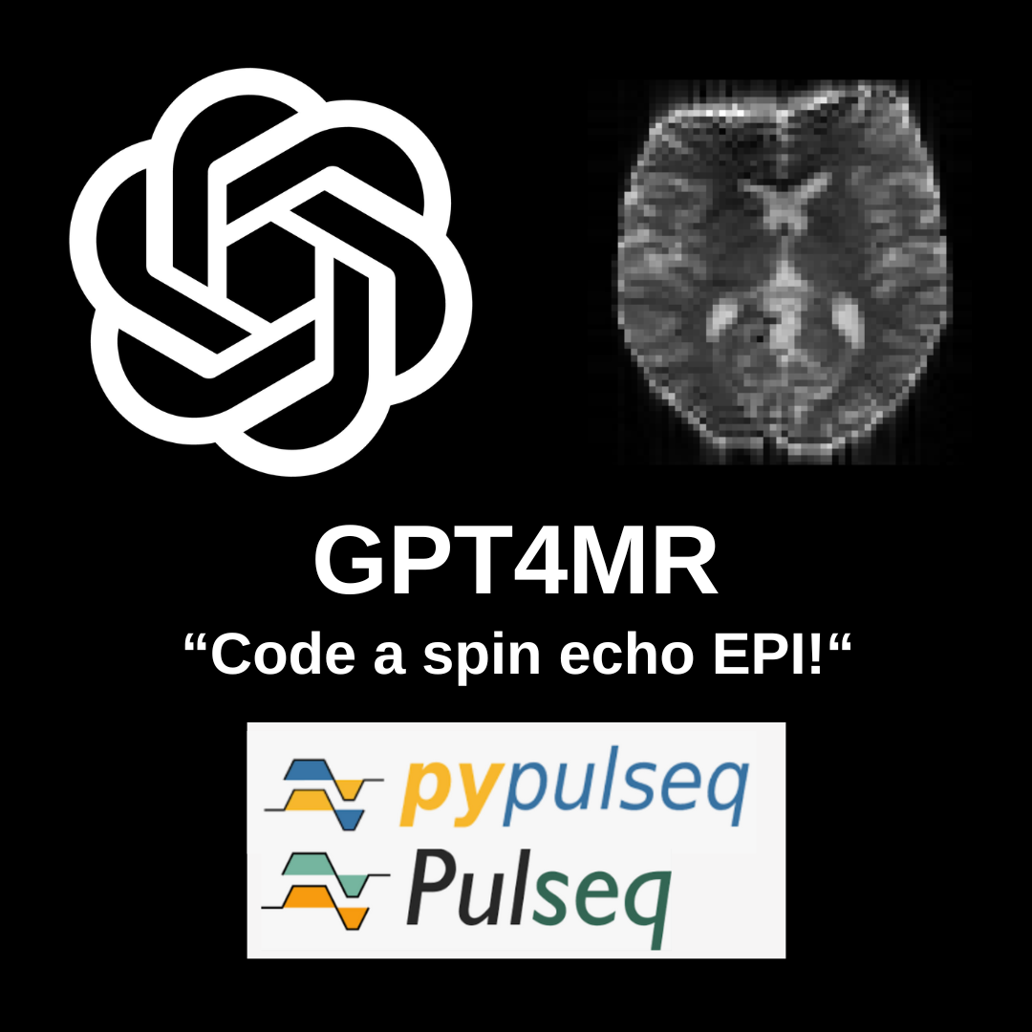
Simulation enables…
… fast feedback to find bugs / new techniques.
… to solve more mistakes before a real scan.
… to understand artifacts (encoded/non-encoded/recon-related)
SE-EPI
bSSFP
stop band

Slide 20
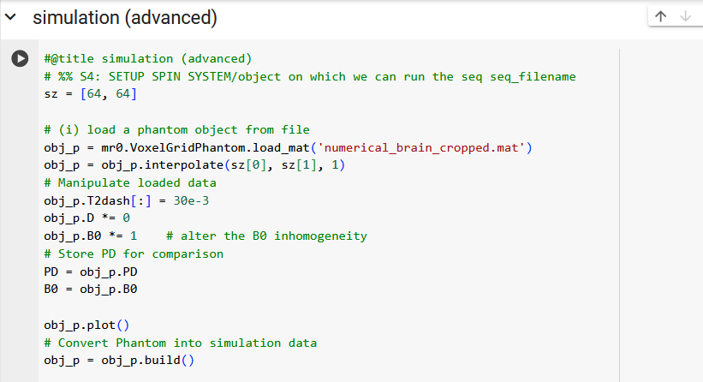
Colab – MR-zero simulation (advanced)
Define object parameters obj_p using brain phantom

Slide 21
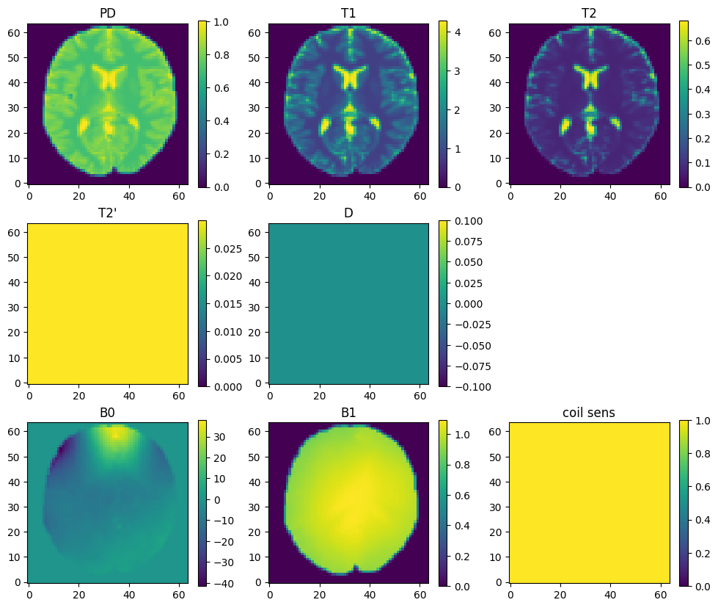
Colab – MR-zero simulation (advanced)
Define object parameters obj_p

Slide 22
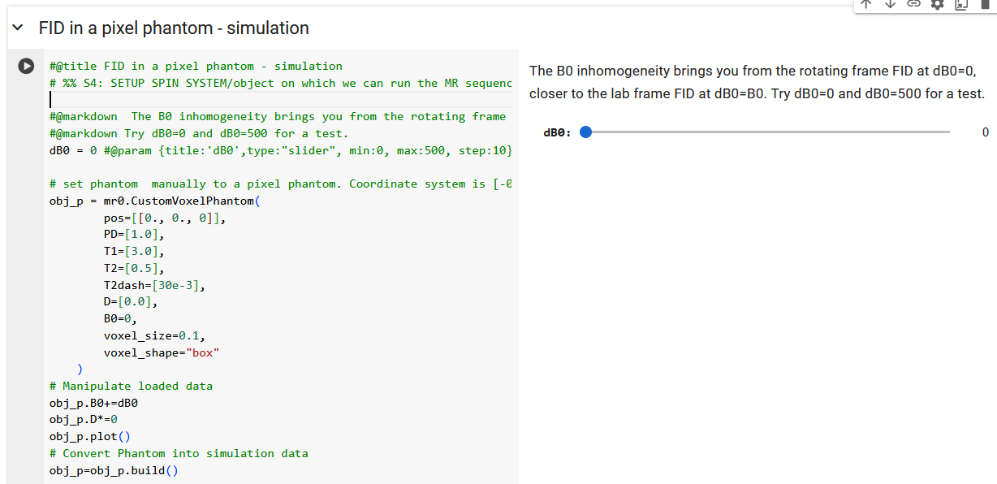
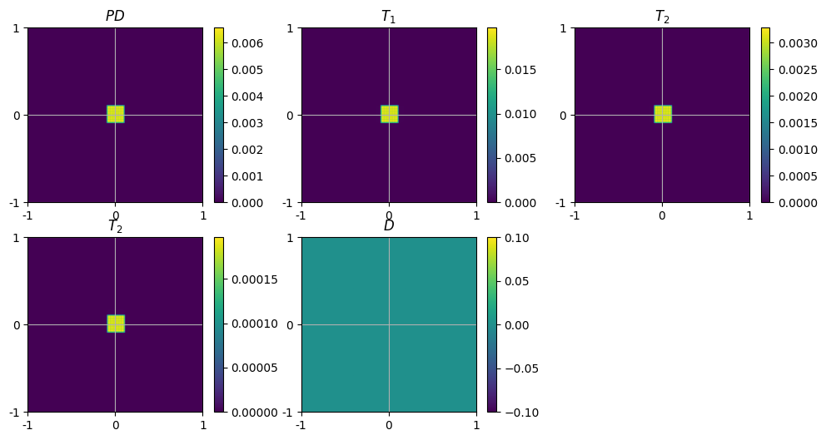
Colab – MR-zero simulation (advanced)
Define object parameters obj_p using a pixel phantom

Slide 23
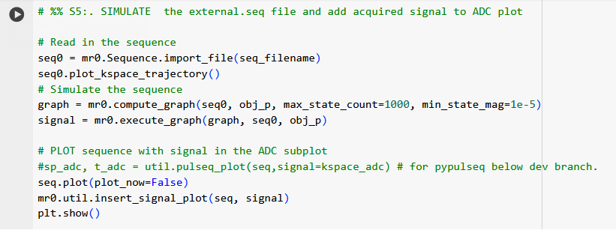
Colab – MR-zero simulation (advanced)
Compute and execute phase distribution graph

Slide 24
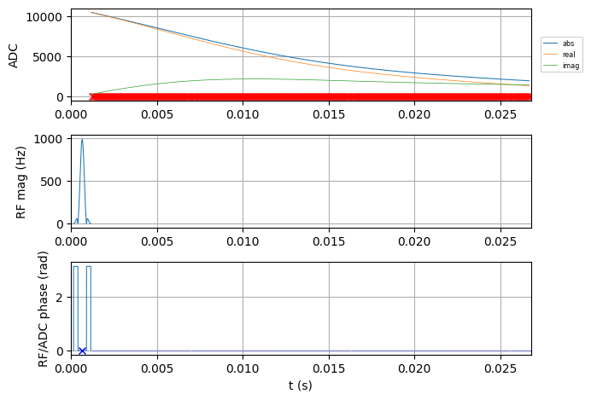
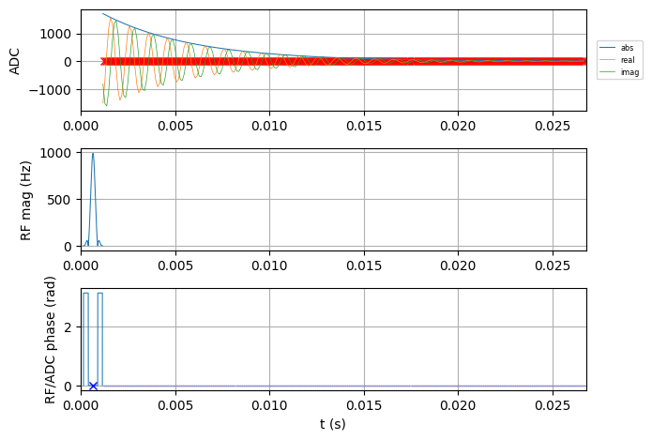
Play with the simulation!
dB0 10 Hz
dB0 100 Hz
dB0 1000 Hz, short T2*

Slide 25
Basic Sequences – spin echo
spin echo
Two RF pulses
ADC event
Accurate timing!
t [s]

Slide 26
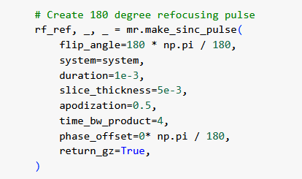
Basic Sequences – spin echo

Slide 27
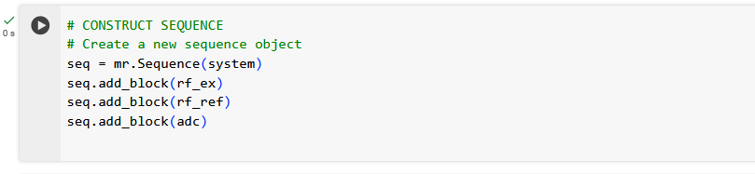
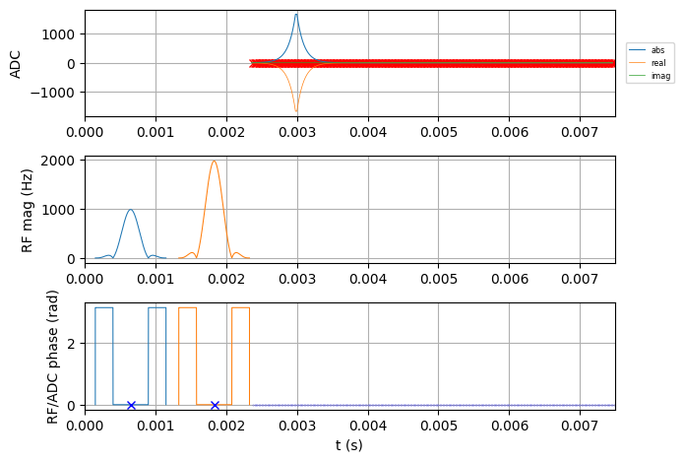
Basic Sequences – spin echo

Slide 28
Basic Sequences – spin echo

Slide 29
Basic Sequences – spin echo

Slide 30
Basic Sequences – spin echo
Delay=0.15 ms
Delay=0.15 ms

Slide 31
Basic Sequences – spin echo
MinTE/2
MinTE/2
Delay=0.15 ms
Delay=0.15 ms

Slide 32
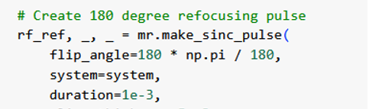
Basic Sequences – spin echo
minTE/2
minTE/2
ct_ref=mr.calc_rf_center(rf_ref) # rfex center time
ct_ref=mr.calc_rf_center(rf_ref) # rfref center time
minTE2 = ct_ex[0]+ ct_ref[0] + rf_ref.delay
+ rf_ex.ringdown_time
= 0.5 ms + 0.5 ms + 0.15 ms
+ 30µs
= 1.18 ms
Delay=0.15 ms
Delay=0.15 ms

Slide 33
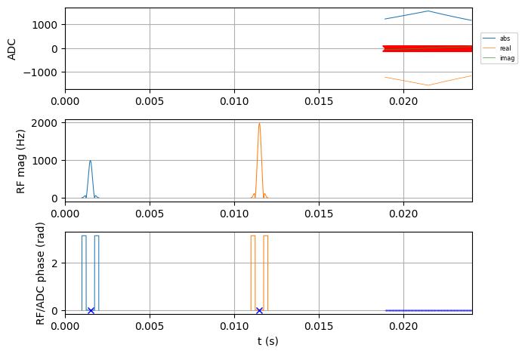
Basic Sequences – spin echo
d2 = minTE2+d1
-ct_ref[0] -rf_ex.ringdown_time
-adc.delay -Nread*dwell/2
d1
d2
#TE/2
TE = 20e-3
d1 = TE/2-minTE2

Slide 34
Basic Sequences – spin echo
TE = 20e-3 s

Slide 35
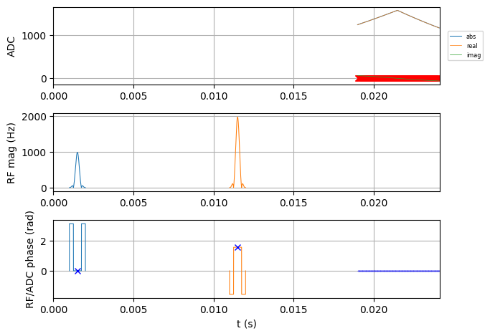
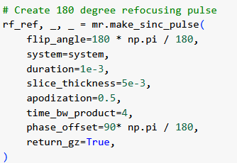
Basic Sequences – spin echo
TE = 20e-3 s

Slide 36
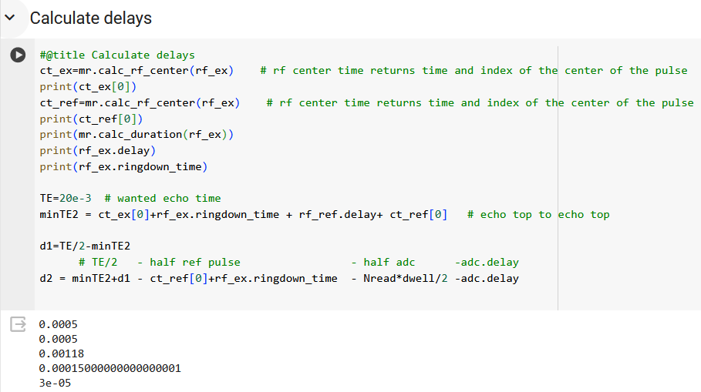
Basic Sequences – spin echo

Slide 37
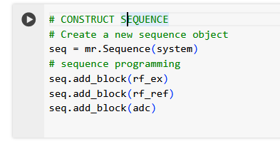
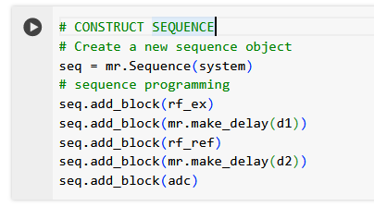
Basic Sequences – spin echo
Naïve spin echo
Correct spin echo

Slide 38
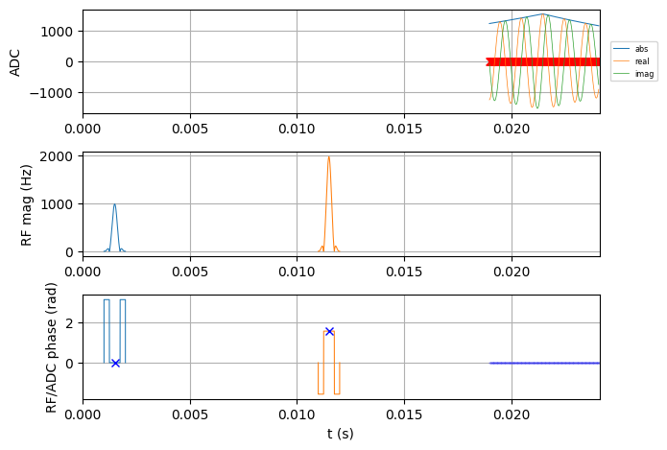
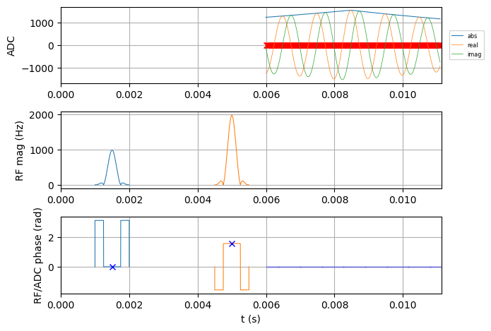
Basic Sequences – spin echo - let‘s play
dB0=10 Hz
dB0=1000 Hz
minTE + ADC/2

Slide 39
Basic Sequences - GRE
gradient echo
Rf pulse
ADC
Readout gradient
Rewinder gradient
t [s]

Slide 40
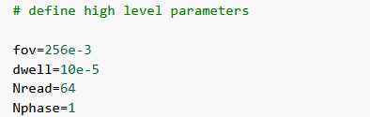
Basic Sequences - GRE
gx =mr.make_trapezoid(channel='x',flat_area=Nread/fov,flat_time=Nread*dwell)
flat_time
fall_time
# CONSTRUCT SEQUENCE
# Create a new sequence object
seq = mr.Sequence(system)
seq.add_block(rf_ex)
adc.delay=gx.rise_time
seq.add_block(adc,gx)
rise_time
flat_area
area
duration

Slide 41
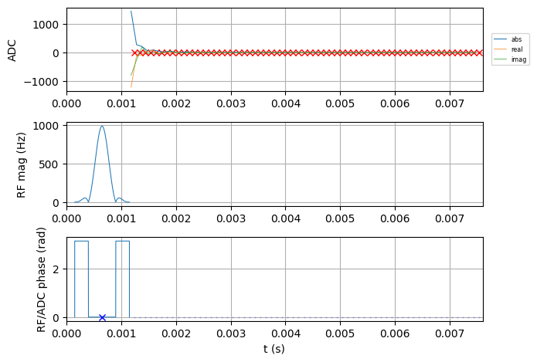
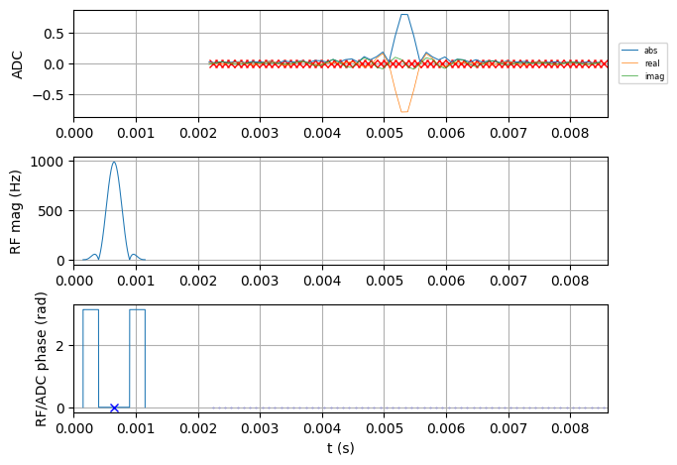
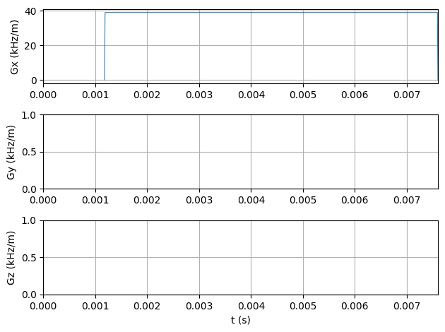
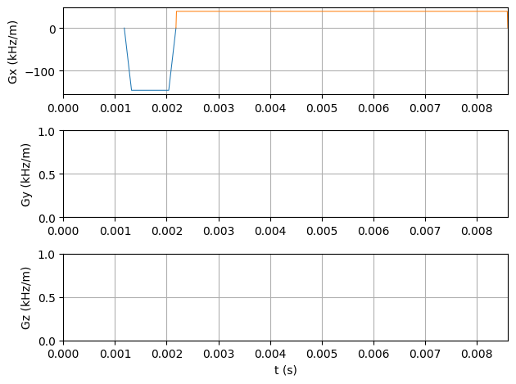

Slide 42
Basic Sequences - GRE
gx =mr.make_trapezoid(channel='x',flat_area=Nread/fov,flat_time=Nread*dwell)
gx_pre =mr.make_trapezoid(channel='x', area=-gx.area/2,duration=1e-3)
flat_time
fall_time
# CONSTRUCT SEQUENCE
# Create a new sequence object
seq = mr.Sequence(system)
seq.add_block(gx_pre)
seq.add_block(rf_ex)
adc.delay=gx.rise_time
seq.add_block(adc,gx)
rise_time
flat_area
area
duration

Slide 43
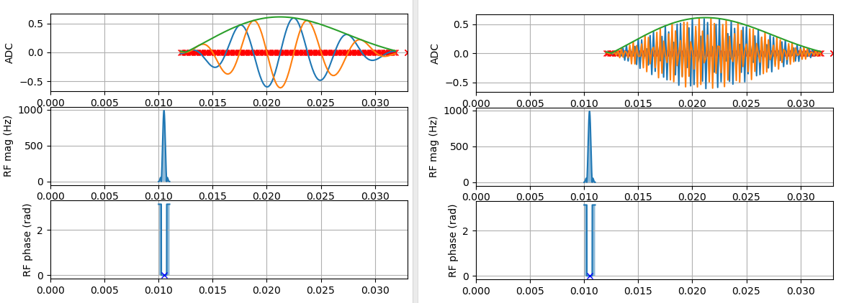

Basic Sequences – 1D GRE
The gradient echo yields spatial encoding:
„Pixels at the edge generate fast oscillations“
t [s]
t [s]

Slide 44
Coffee Break!

